Slide 1
Discrete Mathematics Lecture 3

Slide 2
Predicates (Propositional Function) and Quantifiers

Slide 3
Predicates (Propositional Function)
So far we can represent the statement – “10 > 100” or “10 <= 100”
But we can’t represent - “x > 3,” “x = y + 3,” “x + y = z,”
Can represent – “Rahim knows C programming.”
Can’t represent – “X knows C programming.”
Can’t represent – “Every student know C programming.”
Can’t represent – “At least one student know C programming.”

Slide 4
Predicates : “x is greater than 3”
“x is greater than 3” has two parts
“x is greater than 3” – the variable x, is the subject of the statement.
“x is greater than 3” – the predicate, refers to a property that the subject of the statement can have.

Slide 5
Predicates : “x is greater than 3”
We can denote the statement “x is greater than 3” by P(x),
Where P denotes the predicate “is greater than 3” and
x is the variable.
The statement P(x) is also said to be the value of the propositional function P at x.
Once a value has been assigned to the variable x, the statement P(x) becomes a proposition and has a truth value.
Q: Let P(x) denote the statement “x > 3.” What are the truth values of P(4) and P(2)?

Slide 6
Predicates : Some Example
Example 1
Let Q(x, y) denote the statement “x = y + 3.” What are the truth values of the propositions Q(1, 2)and Q(3, 0)?
Example 3
Let R(x, y, z) denote the statement “x + y = z.” What are the truth values of the propositions R(1,2,3) and R(0,0,1)?

Slide 7
Quantifiers
What is it?
Quantification is a way to create a proposition from a propositional function (predicate).
Quantification expresses the extent to which a predicate is true over a range of elements.
English words all, some, many, none, and few are used in quantifications.

Slide 8
Quantifiers : Types
THE UNIVERSAL QUANTIFIER
THE EXISTENTIAL QUANTIFIER

Slide 9
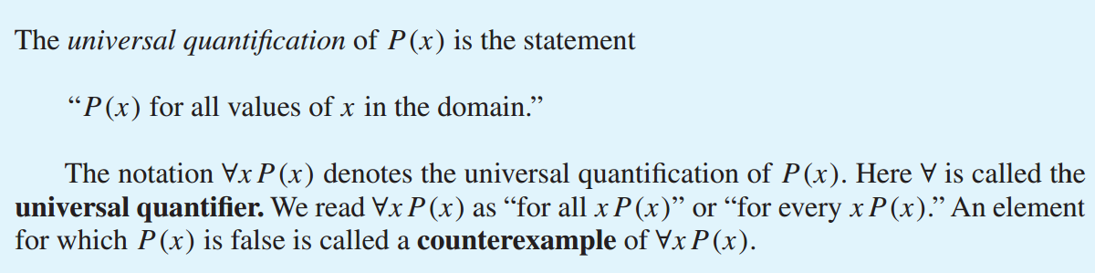
The Universal Quantifier
Definition

Slide 10
The Universal Quantifier : True/False?
Statement | When True? | When False?
∀x P(x) | P(x) is true for every x | There is an x for which P(x) is false.
P(x) = “Student x knows C programming.”
Domain : This Class!
When true?
If every student knows programming
When false?
If at least one student does not know

Slide 11
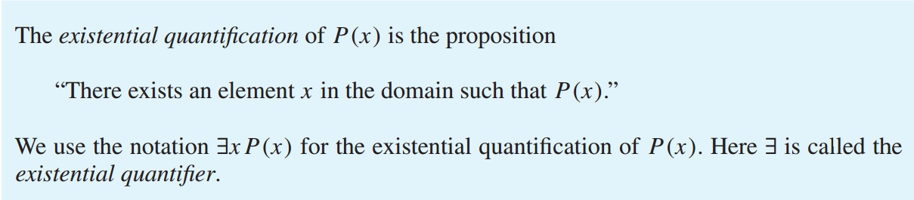
The Existential Quantifier
Definition

Slide 12
The Existential Quantifier : True/False?
Statement | When True? | When False?
∃x P(x) | There is an x for which P(x) is true. | P(x) is false for every x.
P(x) = “Student x knows C programming.”
Domain : This Class!
When true?
If at least one student knows programming
When false?
If every student does not know

Slide 13
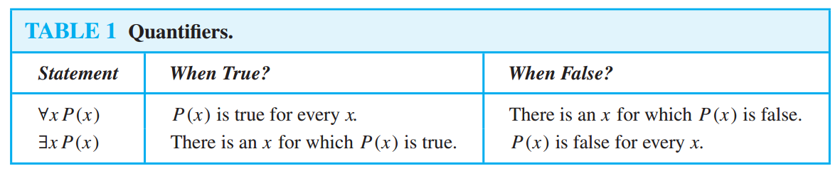
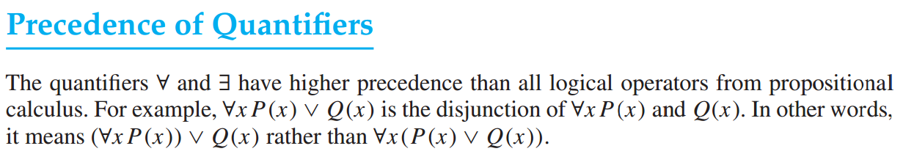
Summarize

Slide 14
Quantifiers : Example
Let Q(x) be the statement “x < 2.” What is the truth value of the quantification ∀x Q(x), where the domain consists of all real numbers?
Solution : Q(x) is not true for every real number x, because, for instance, Q(3) is false. That is, x = 3 is a counter example for the statement ∀x Q(x). Thus ∀x Q(x) is false.
Let P(x) denote the statement “x > 3”. What is the truth value of the quantification ∃x P (x), where the domain consists of all real numbers?
Solution : Because “ x > 3” is sometimes true—for instance, when x = 4, the existential quantification of P(x), which is ∃x P(x), is true.

Slide 15
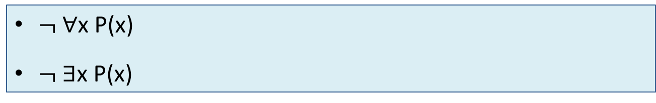
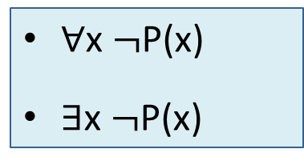
Negating Quantified Expressions
P(x) = “Student x in your class has taken a course in calculus.”
∀x P(x) = “Every student in your class has taken a course in calculus.”
∃x P(x) = “At least one student in this class has taken a course in calculus.”
∀x $¬$P(x)
∃x $¬$P(x)
$¬$∀x P(x)
$¬$∃x P(x)

Slide 16
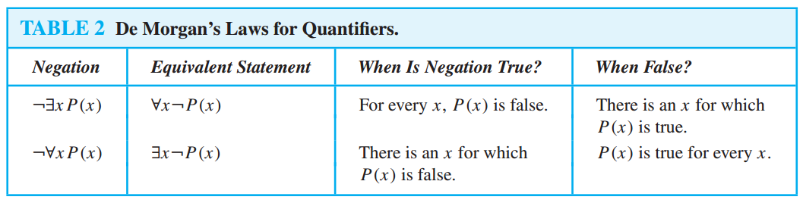
Negating Quantified Expressions

Slide 17
Translating English Sentences
Express the statement “Every student in this class has studied calculus” using predicates and quantifiers.
Rewrite: “For every student in this class, that student has studied calculus.”
Use variable x : “For every student x in this class, x has studied calculus.”
C(x), which is the statement “x has studied calculus.”
∀x C(x) [OK, if the domain for x consists of the students in the class]

Slide 18
Translating English Sentences
Express the statement “Every student in this class has studied calculus” using predicates and quantifiers.
“For every person x, if person x is a student in this class then x has studied calculus.”
If S(x) represents the statement that person x is in this class.
∀x (S(x) → C(x))

Slide 19
Thank you

